Slide 1

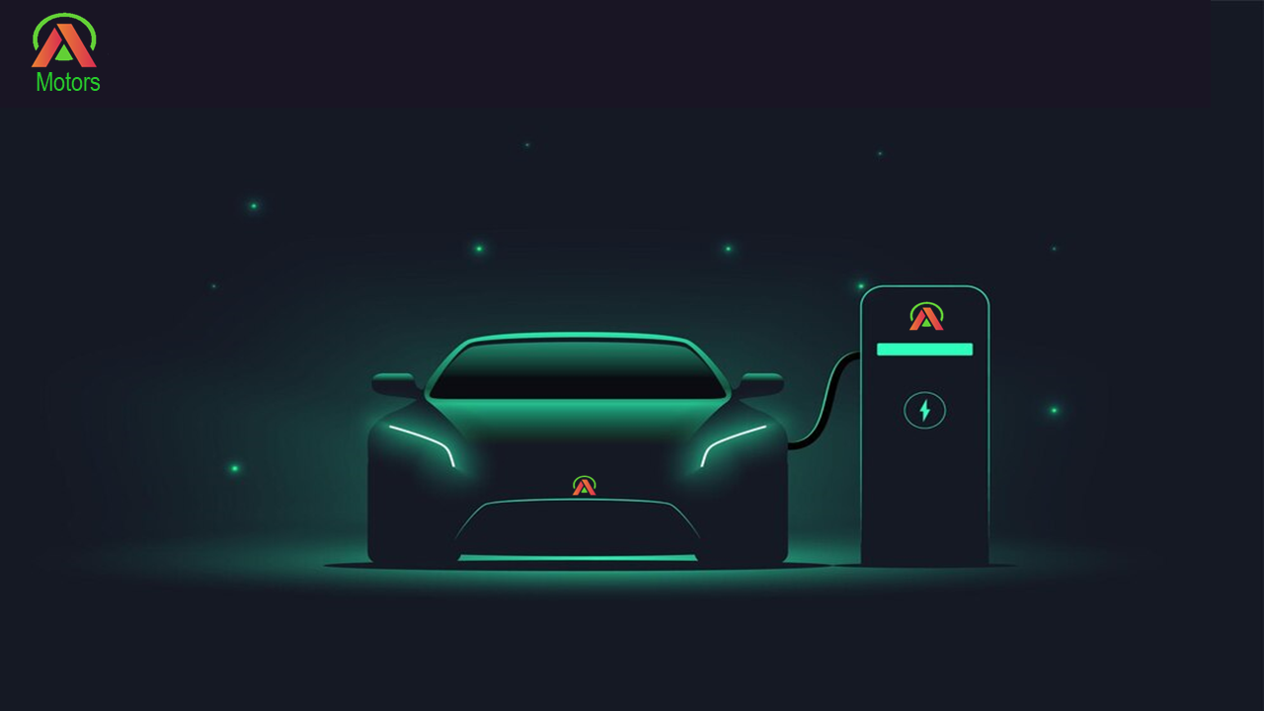
ELECTRIC VEHICLE ANALYSIS
Presented By
ISHWARYA. S

Slide 2
AGENDA
Business Objective
Dashboard Overview
Quick Insights
Benefits of entering Indian Market
Recommendation

Slide 3

BUSSINESS OBJECTIVE
AtliQ Motors is an automotive giant from the USA specializing in electric vehicles (EV). In the last 5 years, their market share rose to 25% in electric and hybrid vehicles segment in North America. As a part of their expansion plans, they wanted to launch their bestselling models in India where their market share is less than 2%.

Slide 4
QUICK INSIGHTS
India's EV market is rapidly growing, with Gujarat leading in growth rate and Maharashtra, Karnataka, Tamil Nadu, Gujarat, and Rajasthan being the top states for EV sales.
Tata Motors dominates 4-wheelers, while Ola Electric leads 2-wheelers.
The EV sales forecast is promising, with expected sales ranging from 2.69M to 3.02M units by 2030.
The West region has the highest number of charging stations, followed by the North, with Maharashtra leading in charging station infrastructure.

Slide 5
BENEFITS OF ENTERING INDIAN MARKET
Utilize FAME II scheme to subsidize EV production and charging infrastructure.
Benefit from a reduced GST rate of 5% , enabling more competitive pricing.
Capitalize on lower production costs to enhance profit margins.
Utilize expanding charging network for improved customer experience
Benefit from supportive state-level initiatives for faster market entry

Slide 6
RECOMMENDATION
AtliQ Motors should enter India's EV market by focusing on 2-wheeler segment in high-growth states like Gujarat and Maharashtra, while investing in charging infrastructure to support rapid adoption and capitalize on the forecasted market growth.

Slide 7
Electrify Your Ride with AtliQ Motors
THANK YOU !

